Slide 1

Team Details
Team New-Bees
Shriya Nandakumar
Anmol Gupta
Srinjana Singha
Breathe | In | Opportunity

Slide 2
Problem Statement
Healthcare domain
Instrument to measure the fear of Covid 19 spread over the world and to find a solution for lack of information on Covid resources
Breathe | In | Opportunity

Slide 3
Idea/Solution Description
Creating a live map of evidences from all around the world showing the number of average active cases
Country specific analysis of Covid cases and state wise comparison of recovery vs death rates using ML model
One stop solution to find Covid resources in your area
Breathe | In | Opportunity

Slide 4
USP
Only website to accumulate all Covid related resources including information from Hospitals, Chemists, Oxygen cylinder suppliers with related links and contact numbers
Breathe | In | Opportunity

Slide 5
Market Research
https://www.who.int/countries/ind/
https://www.investindia.gov.in/bip#sections-2
https://www.zoho.com/covid/india/
https://covid19.who.int/region/searo/country/in
These are some of the common website links which showcases different datas and analysis of the current situation in an interactive dashboard. But what they lack is visual representations with graphs and charts as well as separate portals for finding Covid resources.
Breathe | In | Opportunity

Slide 6
Market Demand
There is a growing demand for information about the rising Covid cases so making an all in one portal which contains actual data corresponding to this as well as access to local Covid resources will help spread awareness of this disease and also help getting the resources faster.

Slide 7
Technological Stack
Data Visualisation using Python | Live Map
Machine Learning | Analysis of the Covid data
Web Development using HTML | Creating the webpage
Breathe | In | Opportunity

Slide 8
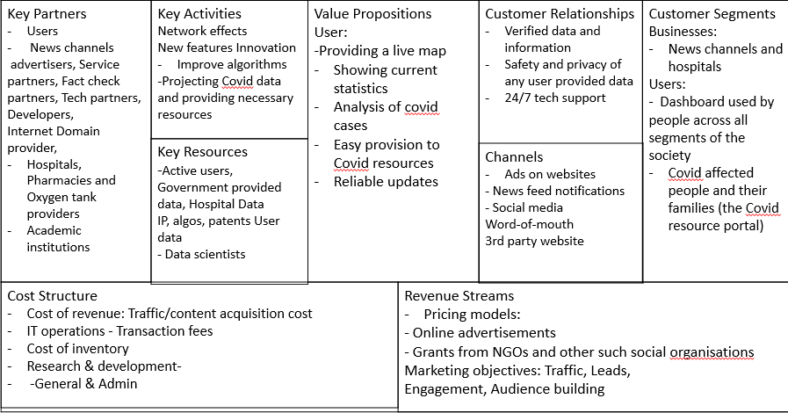
BMC
Show Your BMC
Breathe | In | Opportunity

Slide 9
Future Prospects
Can be used for analysis of economical, agricultural and demographic data in respect to the Covid situation
Useful instrument to depict the trends of other diseases as well like AIDS
Can be used by medical instituitions for their records
Breathe | In | Opportunity

